Slide 1
Demo Script
Contoso Insurance
Azure App Services Code Sample

Slide 2
Prepare the demo
Setup the demo according to the instructions in the README.md file in the GitHub repository.
Copy the following directories to the Mac machine where you will run the iOS Simulator:
/Images/Mobile App Crash Images
/Images/Mobile App OCR Images
When the iOS Simulator loads the app for the first time; close the app, then drag the images from the folders you copied to the Mac machine and drop them into the simulator. This loads the sample images used in the demo into the Pictures app and makes them available in the demo.

Slide 3
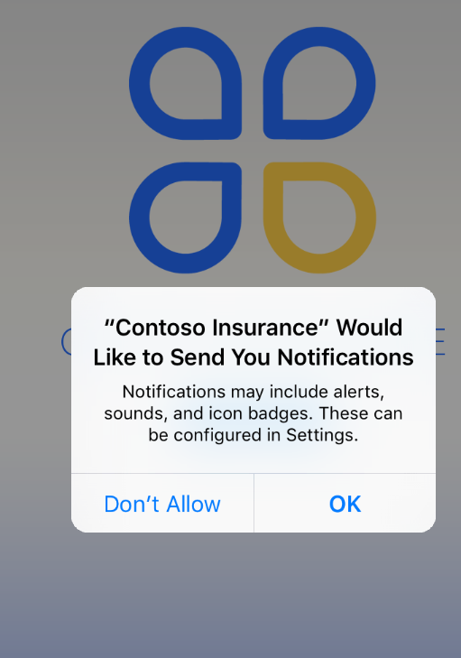
Open the Contoso Insurance mobile app Click OK

Slide 4
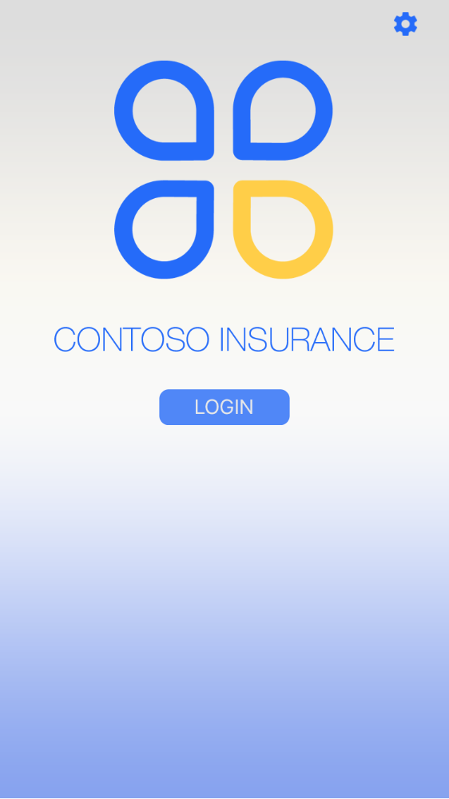
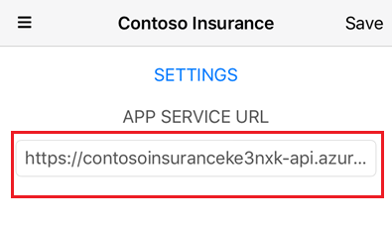
Configure Mobile App
Click the Settings icon
Set the APP SERVICE URL to the API App you created during setup.
Click Save.

Slide 5
Sign In
Click the LOGIN button.

Slide 6
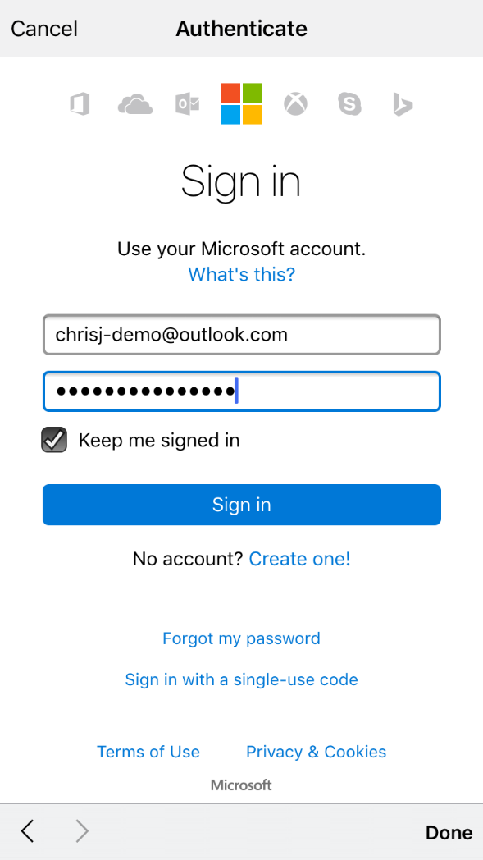
Sign in
Enter the customer account credentials
Click Sign in.
NOTE: This account needs to be a Microsoft Account that you set up as part of the demo setup process.

Slide 7

STOP! Configure The Customer Record In The Database So The Account Can Receive Email
The first time you sign in with a new customer account you must update the customer account in the database so they can receive email.
This is a one time operation.
See the Create Customer User Accounts section in the Src/README.md file to learn how to do this.

Slide 8
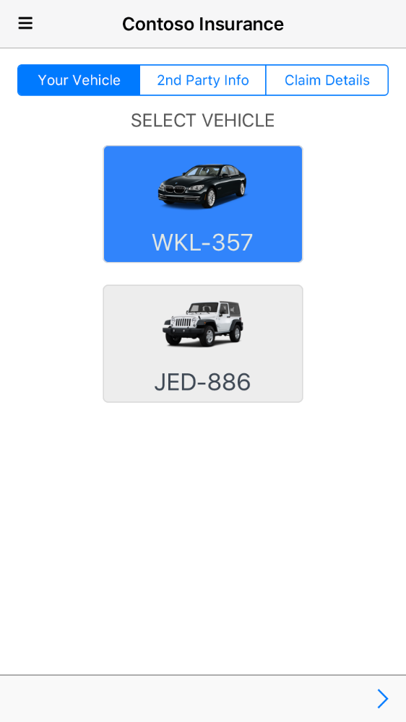
Select Vehicle
Select a vehicle.
Click the next icon.

Slide 9
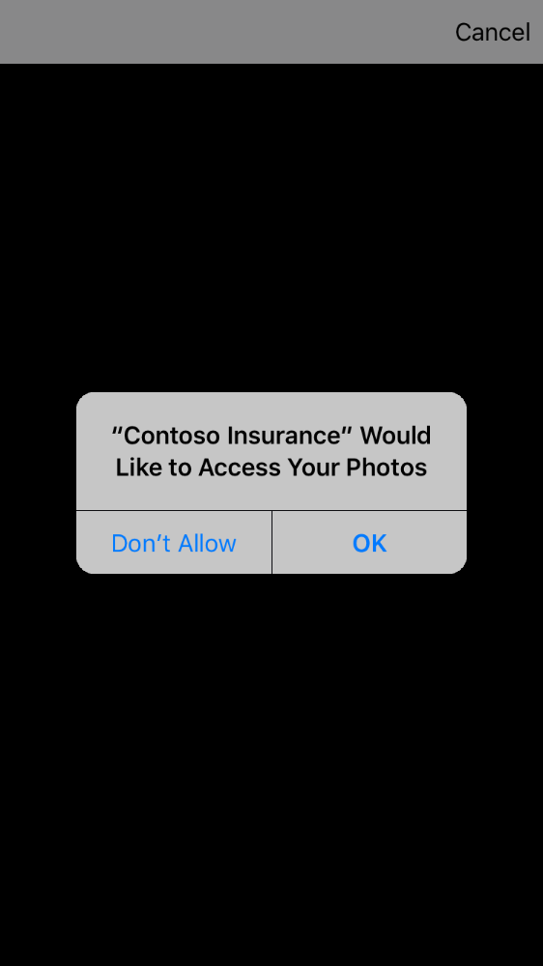
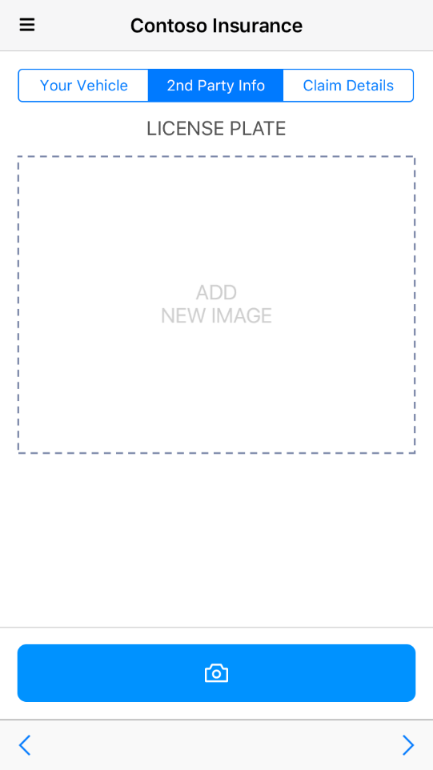
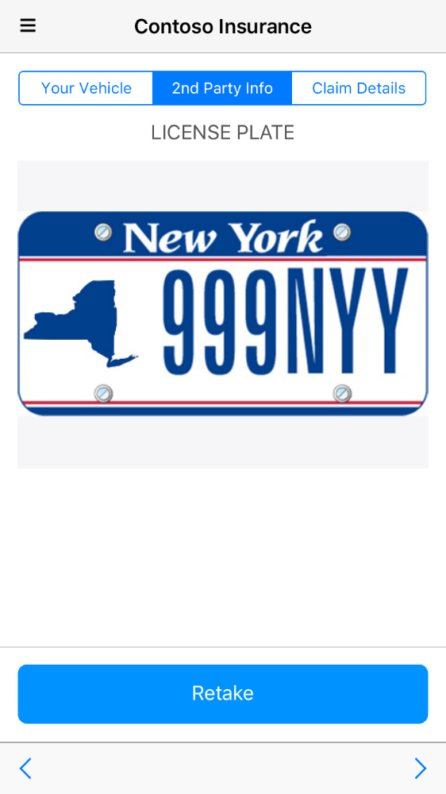
Click OK. Click the camera button and select a 2nd party license plate. Click the next icon.

Slide 10

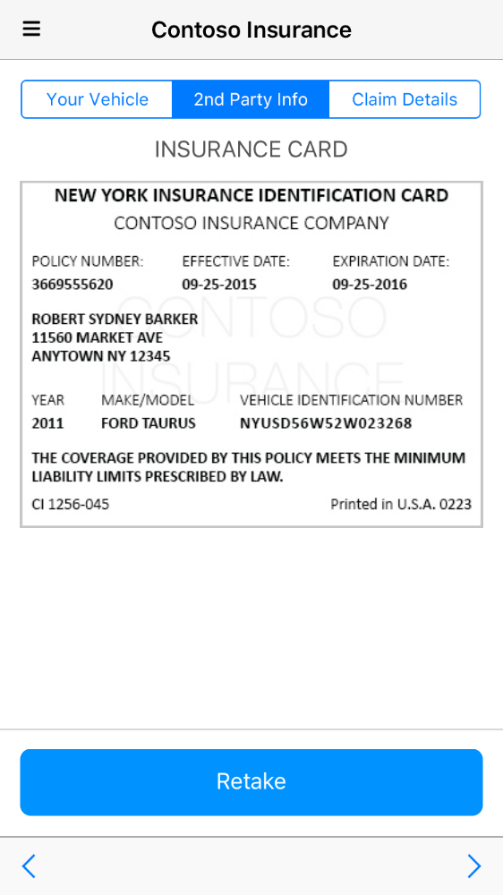
Click the camera button and select the 2nd party insurance card. Click the next icon.

Slide 11

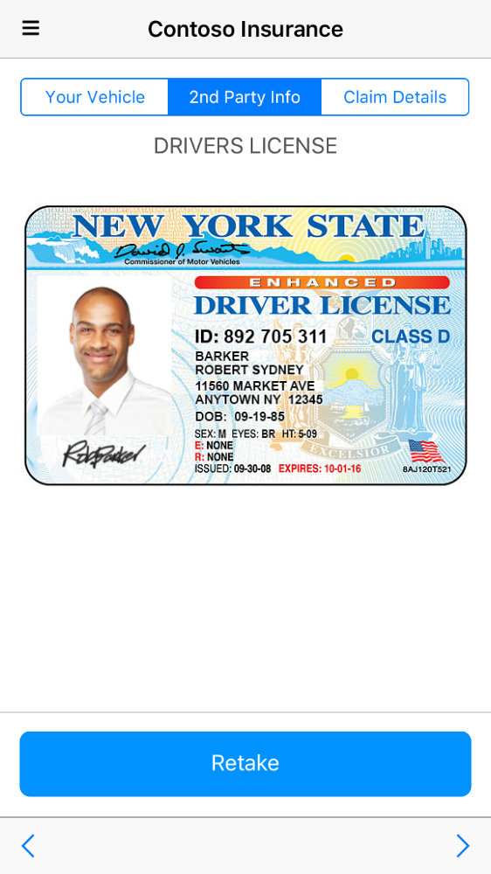
Click the camera button and select the 2nd party driver’s license. Click the next icon.

Slide 12
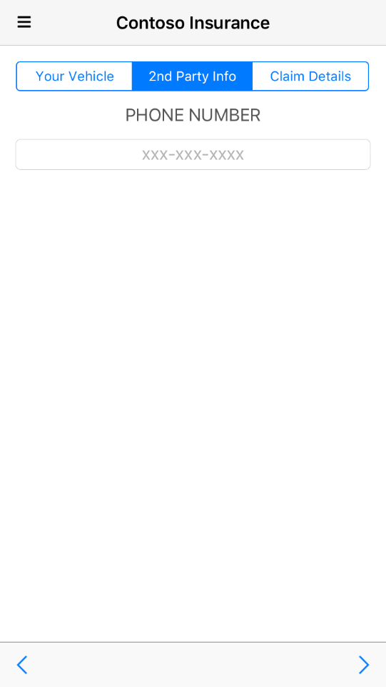
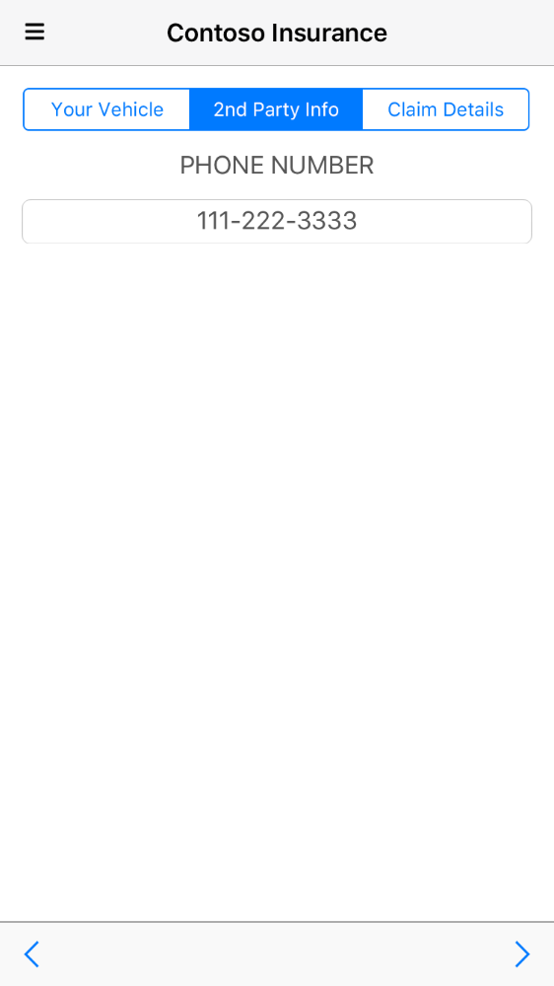
Enter a phone number for the 2nd party. Click the next icon.

Slide 13
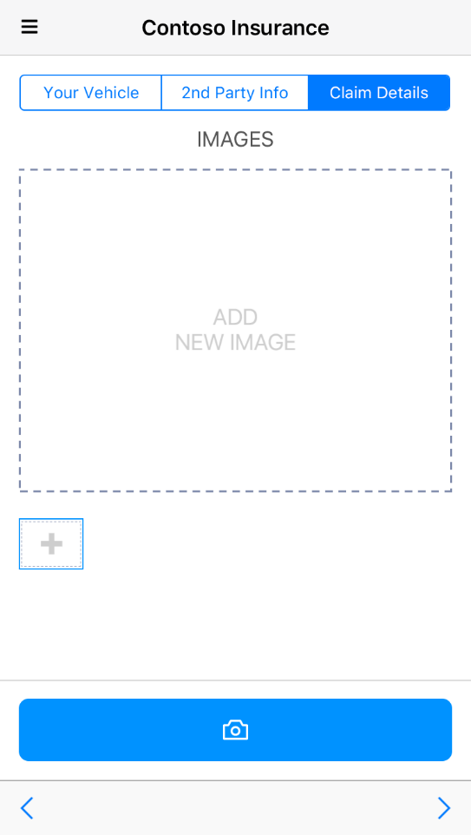
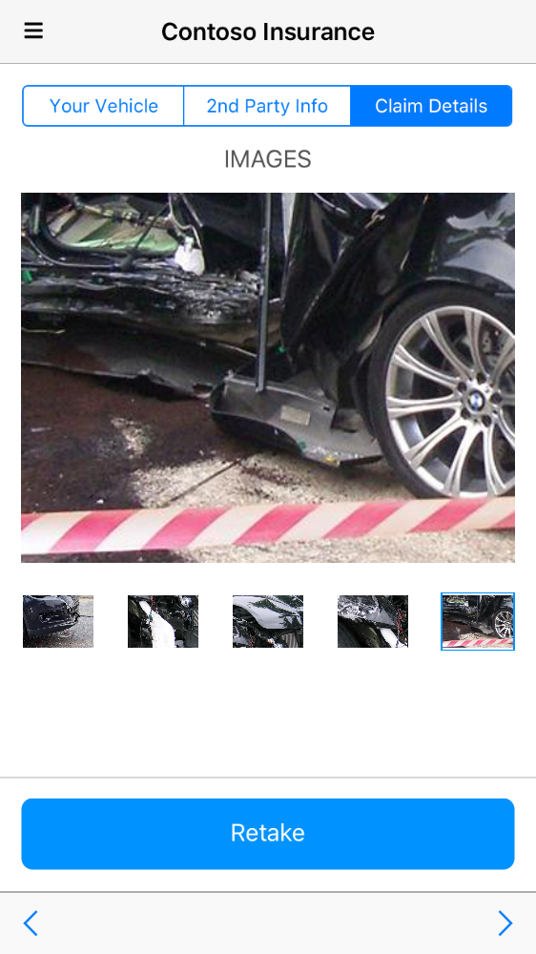
Click the plus button, click the camera button and select a claim image. Repeat this to add multiple claim images. Click the next icon.

Slide 14
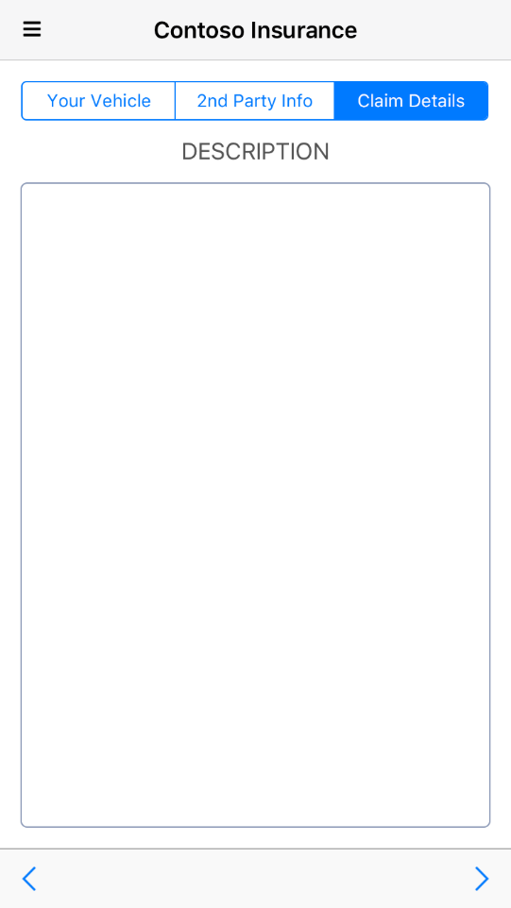
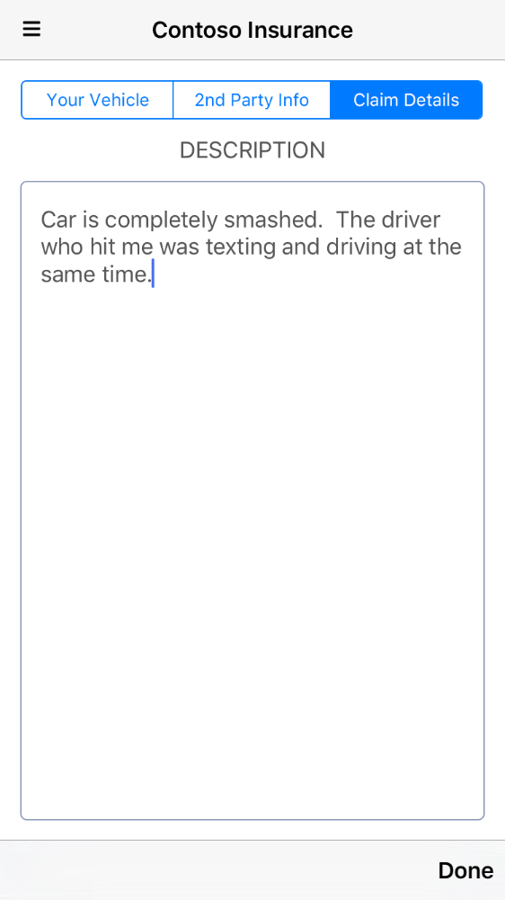
Add a Claim Description. Click Done.

Slide 15
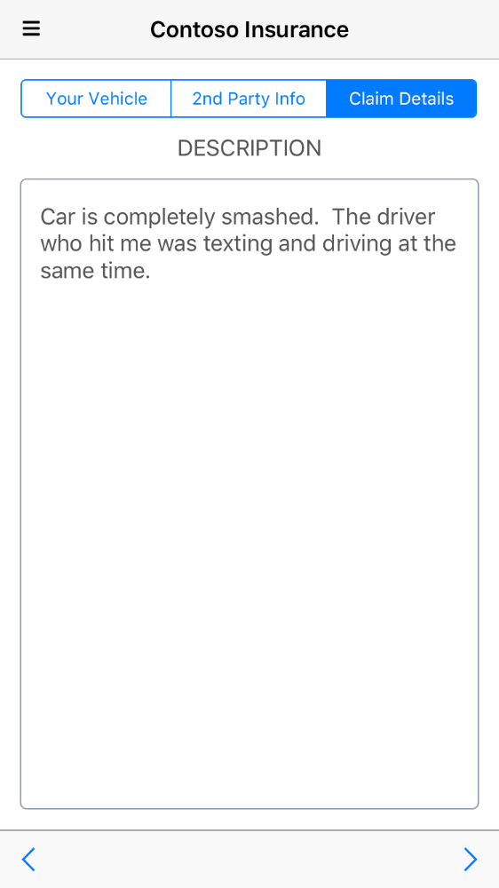
Click the next icon to submit the claim.

Slide 16
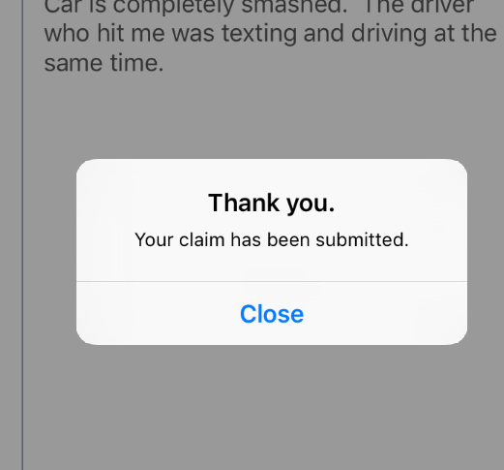
Click the Close button.

Slide 17
View Customer Email
In a web browser, open the email Inbox for the customer’s Microsoft Account you logged into the mobile app with.
(Ex: https://www.outlook.com )
View the email sent to the customer.
If this is the first time you have submitted a claim for the customer their claim will be auto approved and the email will state that.
If this is not the first time you have submitted a claim for the customer their claim will not be auto approved and the email will state that.

Slide 18
View Claims Adjuster Email
In a web browser, open the email Inbox for the claim adjuster’s Organizational Account.
(Ex: https://portal.office.com )
View the email sent to the claims adjuster and click the link in the email to open the web app and view the claim detail.
If this is the first time you have submitted a claim for the customer their claim will be auto approved and the claims adjuster will not receive an email.
If this is not the first time you have submitted a claim for the customer their claim will not be auto approved and the claims adjuster will receive an email.

Slide 19
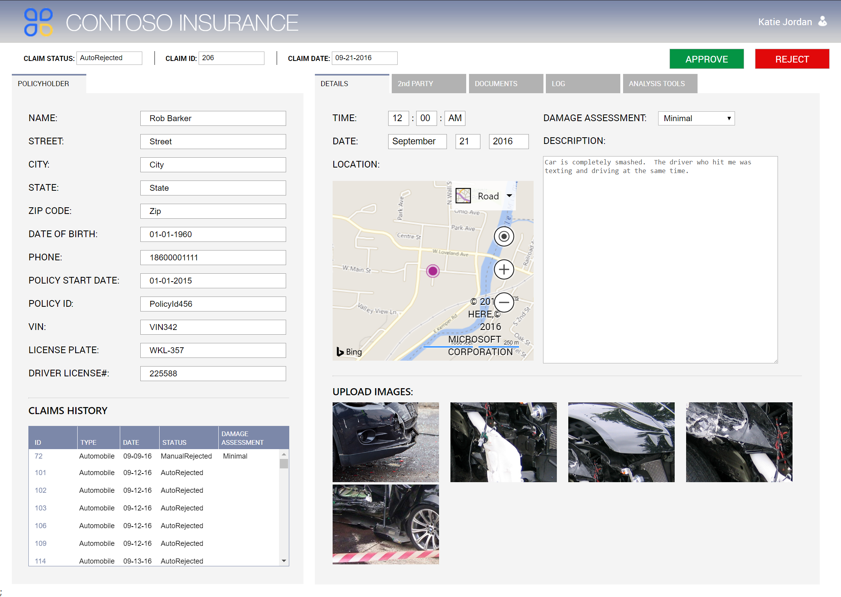
Open the web app and view the data in the DETAILS tab.

Slide 20
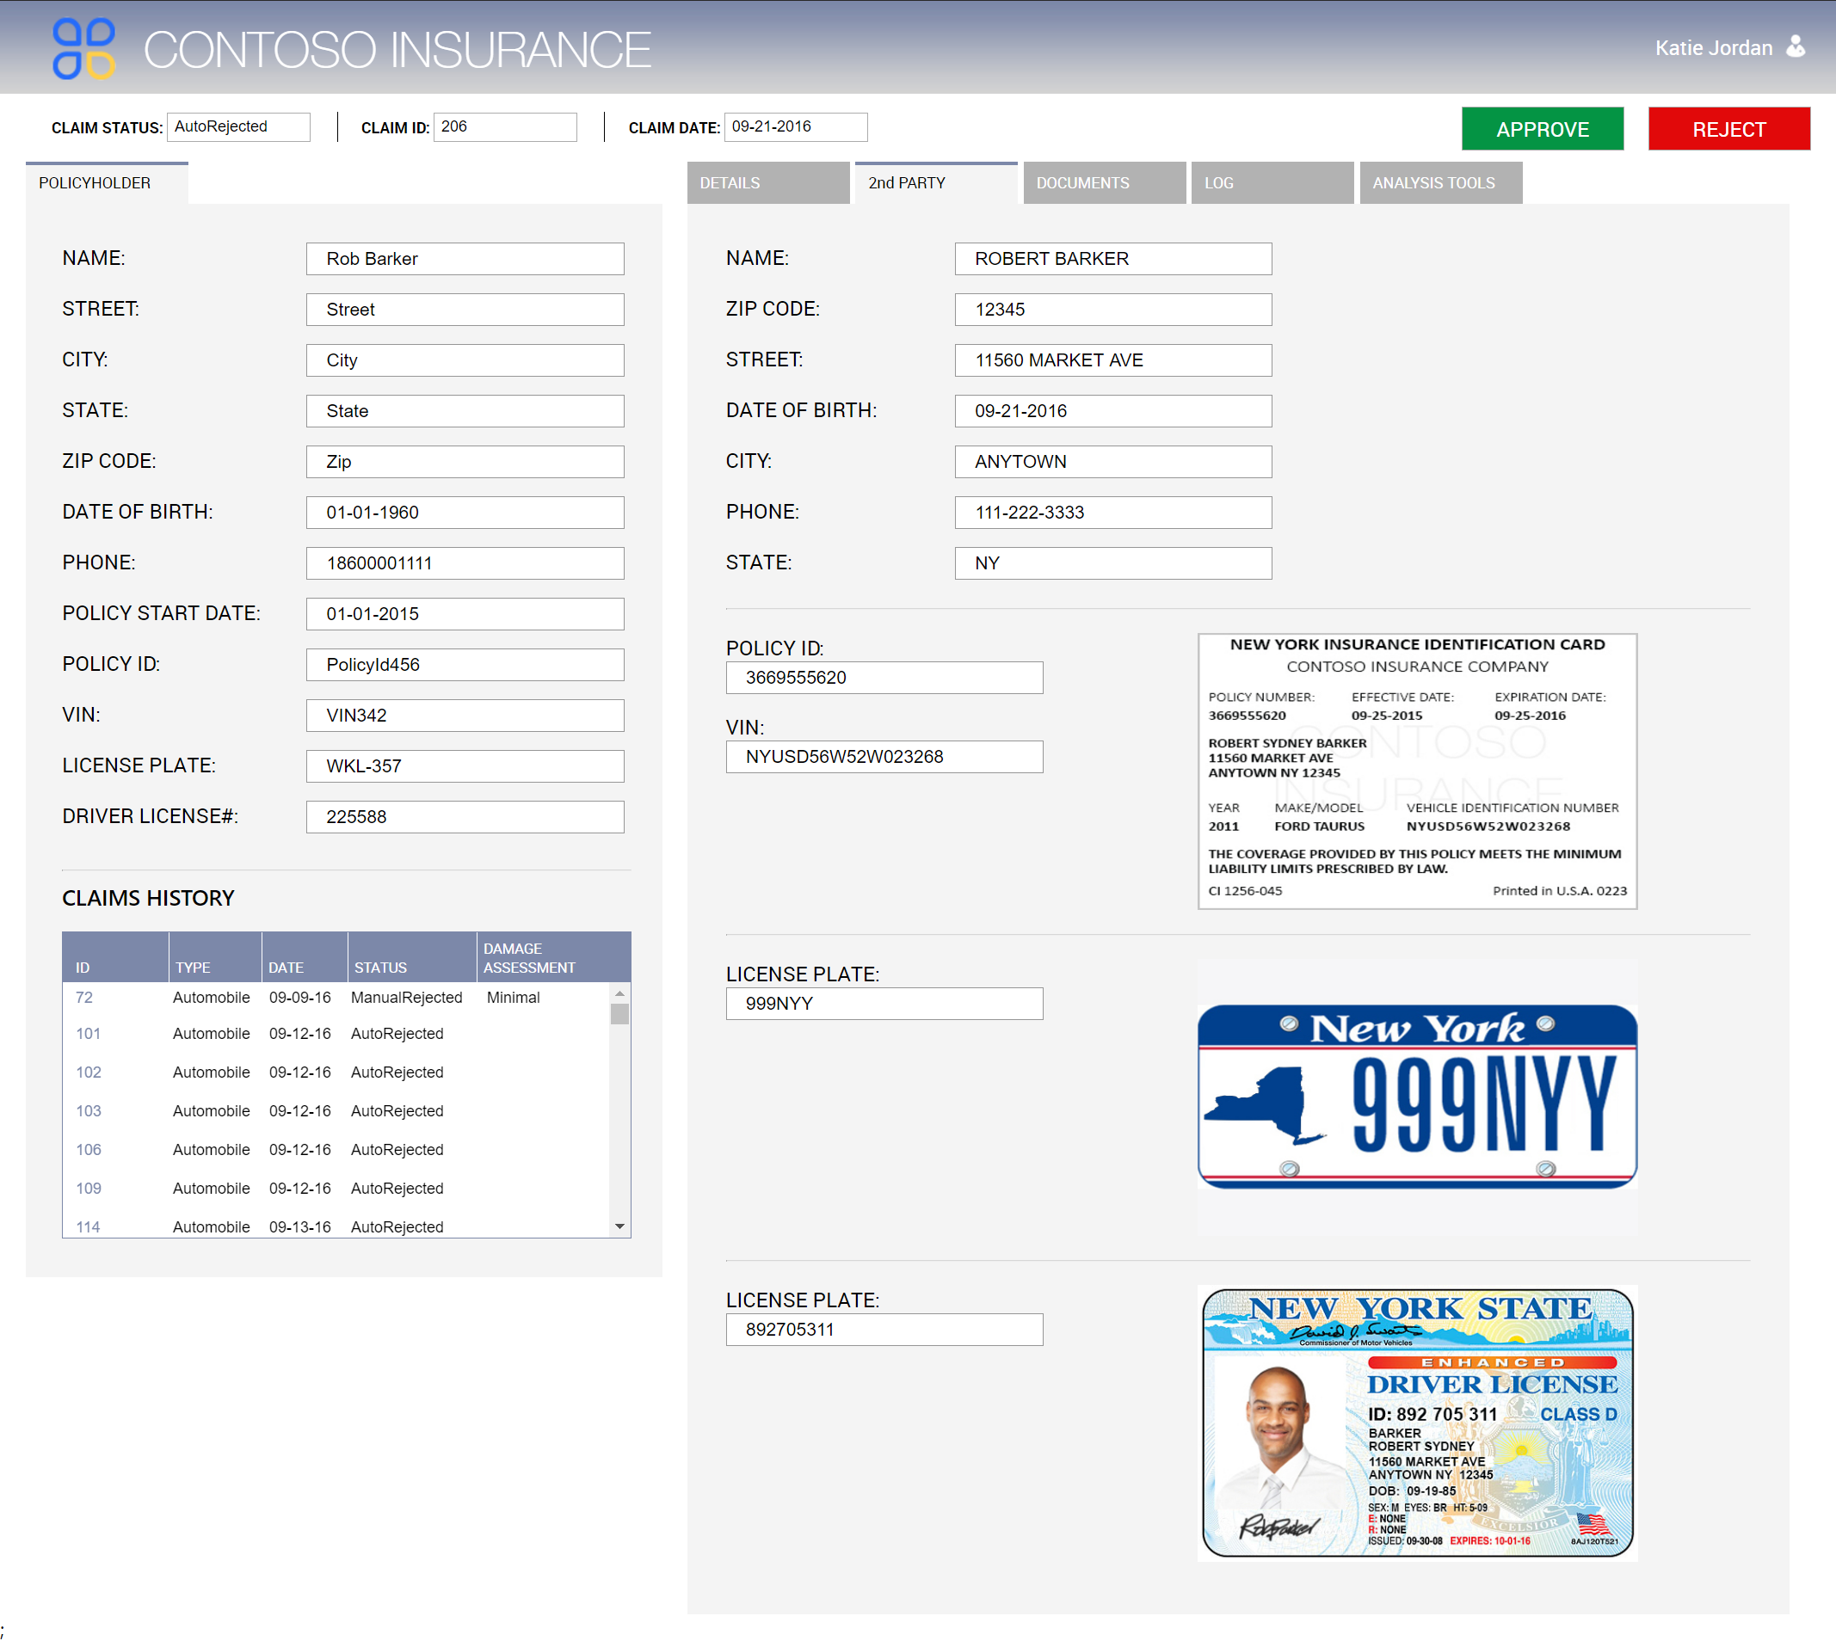
Open the web app and view the data in the 2nd PARTY tab.

Slide 21
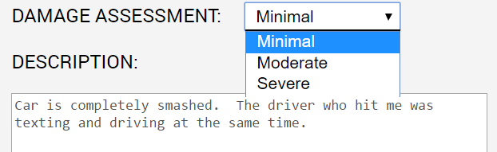
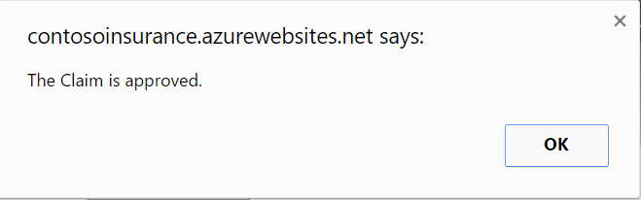
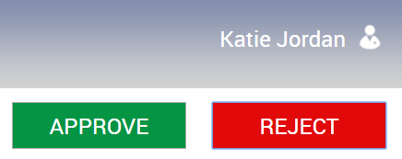

Select the DAMAGE ASSESSMENT value Click APPROVE or REJECT Click OK

Slide 22
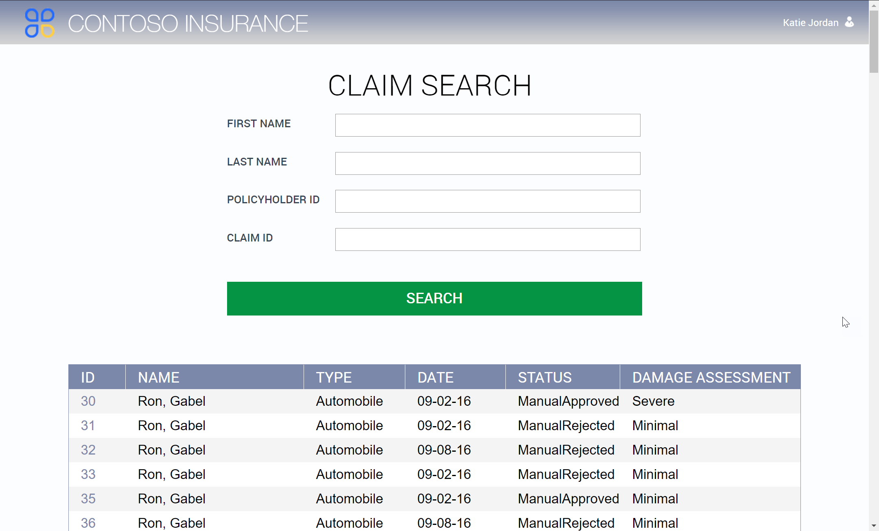
Search For Additional Claims
Open the https://<YOUR WEB SITE>.azurewebsites.net/claims/ page in the web browser.
(Optional) Input search criteria
Click SEARCH
Click a claim ID to open the detail page for the claim

Slide 23
View Customer Email
In a web browser, open the email Inbox for the customer’s Microsoft Account you logged into the mobile app with.
(Ex: https://www.outlook.com )
View the email that indicates if the claim was manually approved or rejected.

